Slide 1




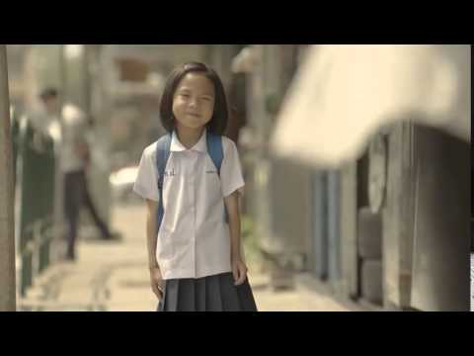

Welcome
Please sit in your forms
Thought of the Week!

Slide 2
Charity
The voluntary giving of help to those in need, as a humanitarian act
Selflessly giving of your
Money
Food
Time or
Oneself

Slide 3
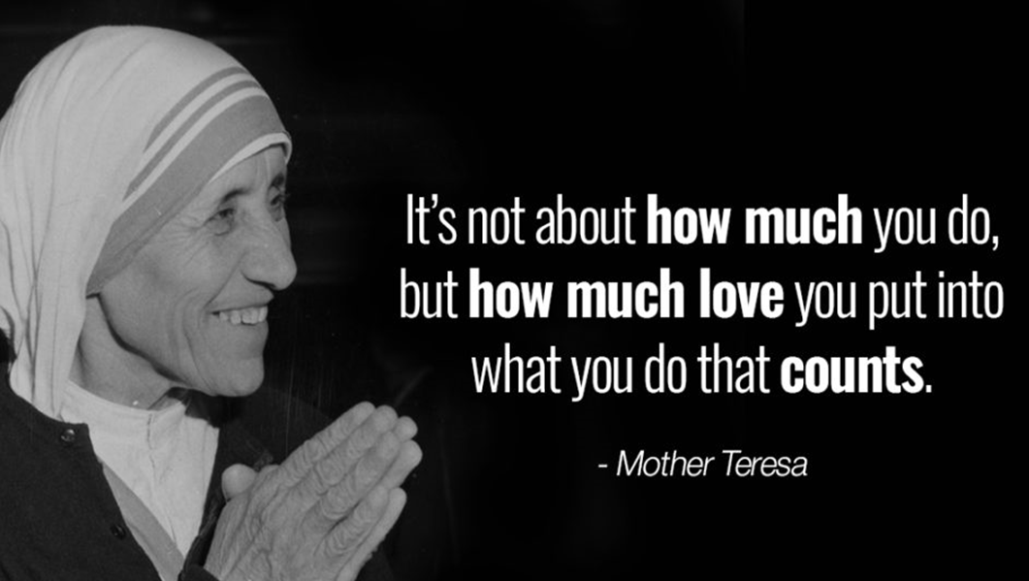

Slide 4
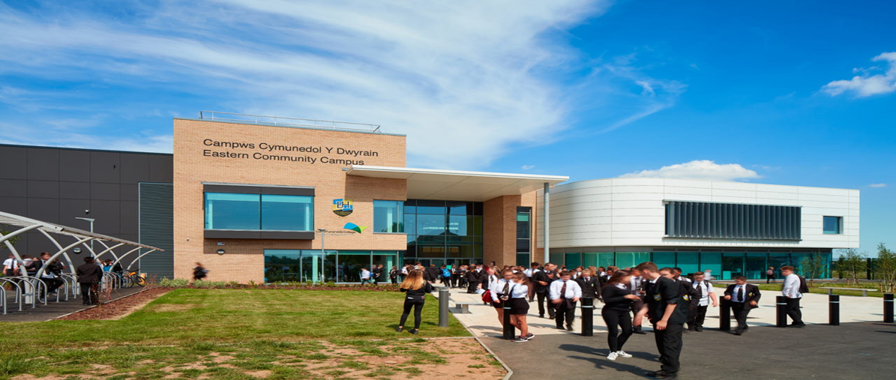
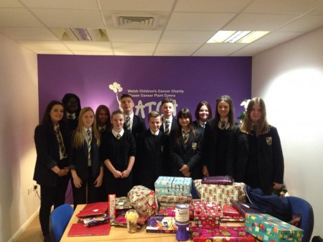
Charity at Eastern High Community Campus
Do we do enough?
Can we be better?

Slide 5

Can you name these charities that we have connections with?

Slide 6

Which charity has this loveable bear as its mascot?

Slide 7

Anyone recognise this mouse from this Welsh Charity?

Slide 8
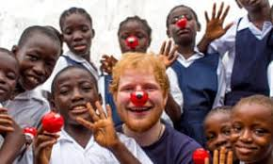
When would you wear a red nose?

Slide 9

Why were some staff growing some awful facial hair?

Slide 10
These are all worthy charities but there is one that is more personal to us at the moment.

Slide 11

This one has recently helped a member of staff and a pupil?

Slide 12

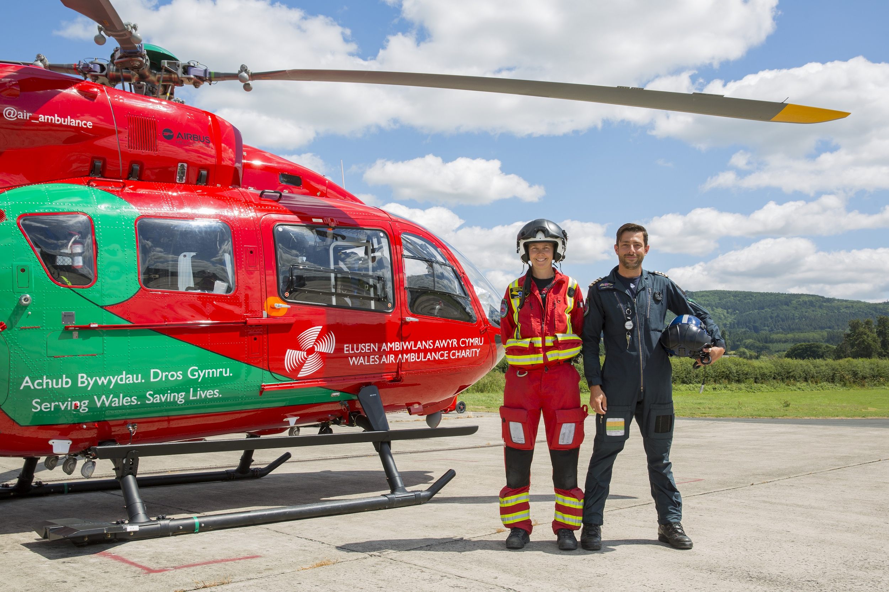
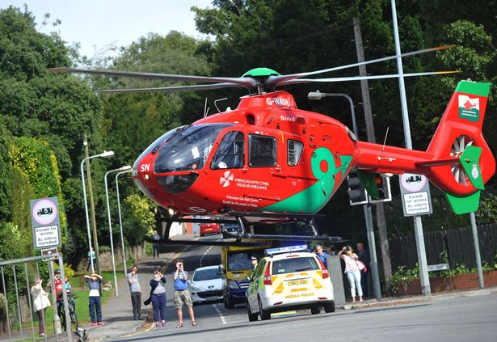

Slide 13
The Wales Air Ambulance helps to:
Transfer poorly children and babies to specialist unit.
Respond to 999 missions using treatments and equipment for children
Fly vulnerable babies in our advanced flight incubator system , keeping tiny lives warm and well oxygenated for their journey
Work closely with neonatal and paediatric experts in Wales who can be flown to critical cases or accompany children on hospital transfers

Slide 14
We are going to raise money for
Wales Air Ambulance
because they helped
Charlie

Slide 15
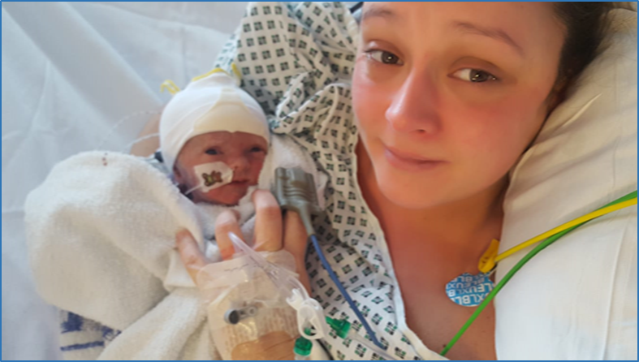
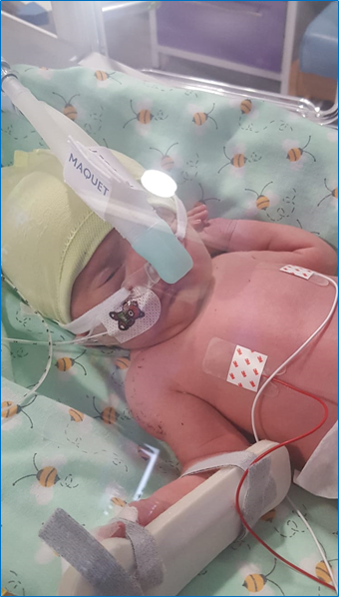
CHARLIE
•Born 4 weeks early
•Weighed just 4lb 12oz
•Needed specialist care
•Born with an enlarged liver and spleen

Slide 16
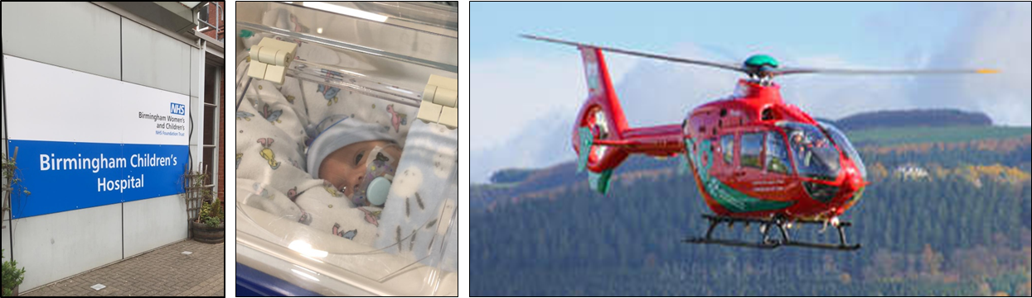

Due to Charlie’s condition he needed to have treatment in Birmingham’s Children’s Hospital which specialises in Liver conditions.

Slide 17
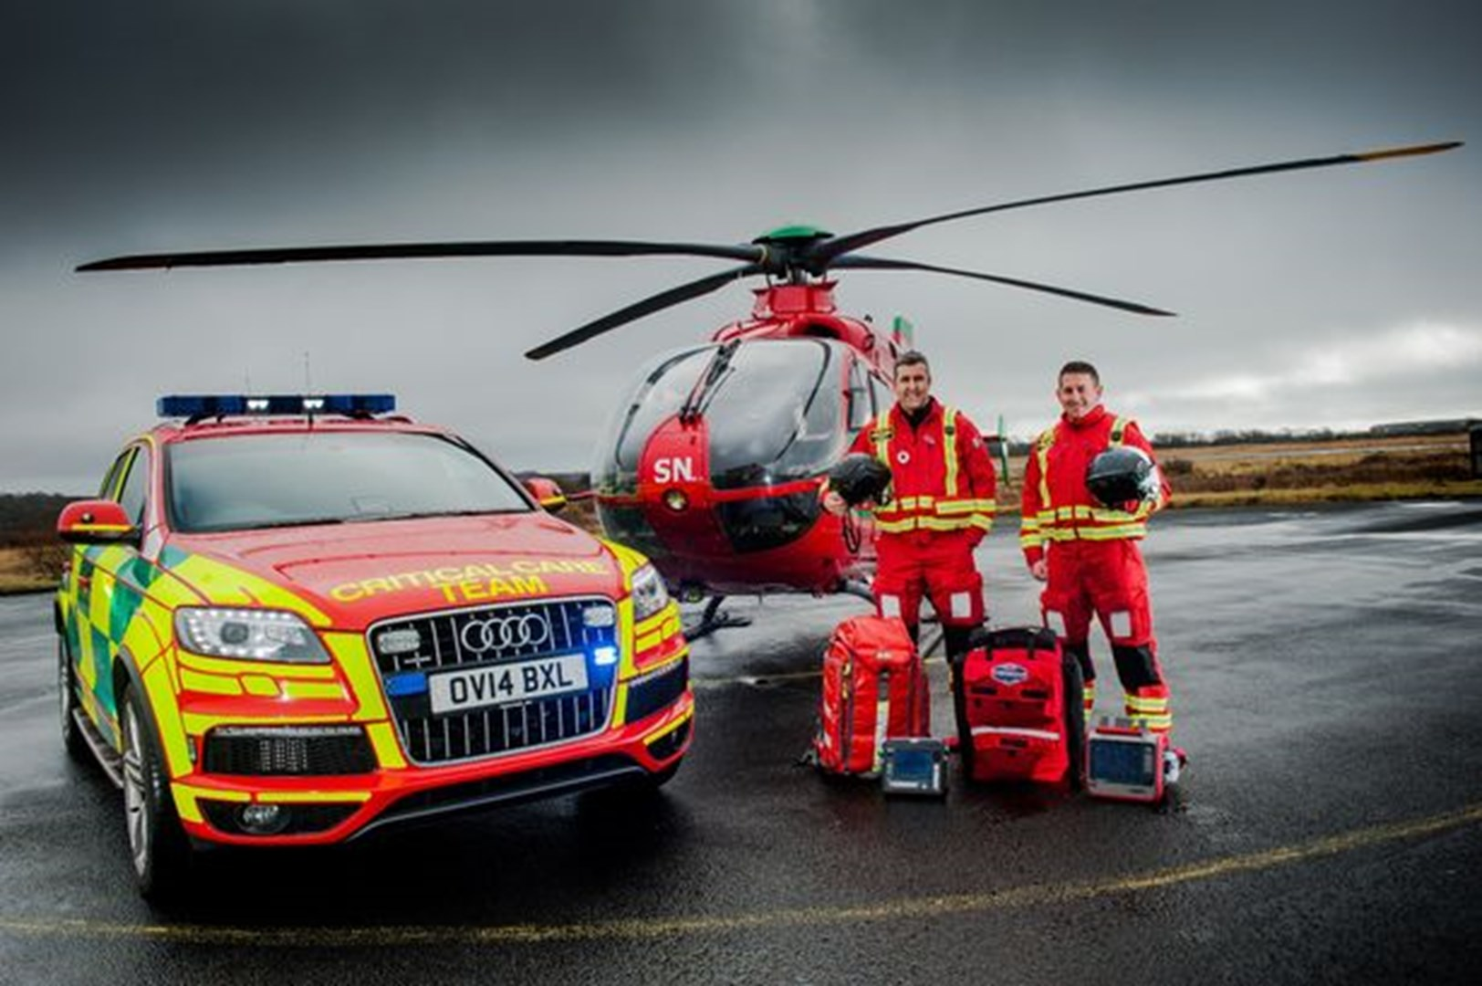
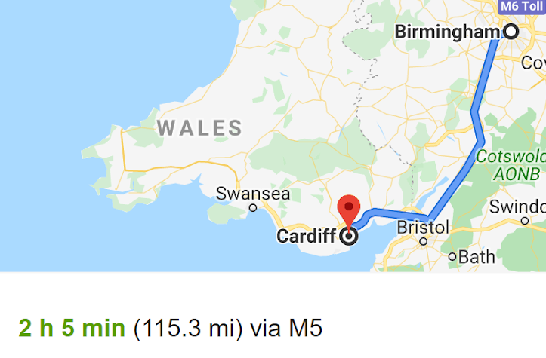
He was transported by Air Ambulance because it was the quickest and fastest form of transport
2h 5mins by car
30 minutes by helicopter

Slide 18
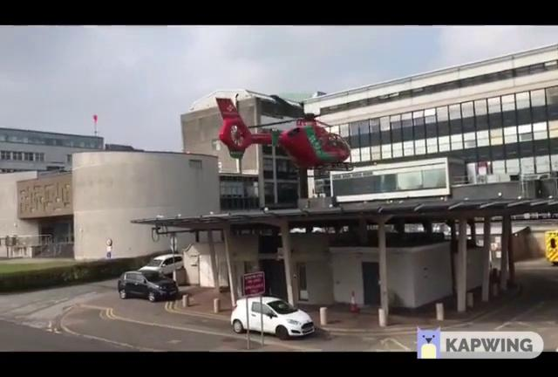
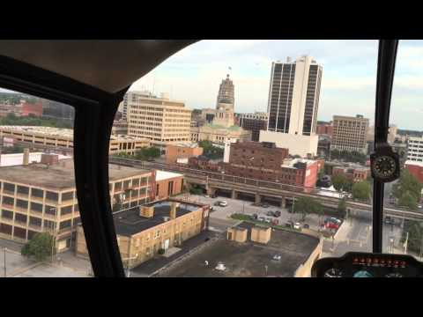
This is the moment he was taken in the helicopter from the University Hospital of Wales to Birmingham

Slide 19
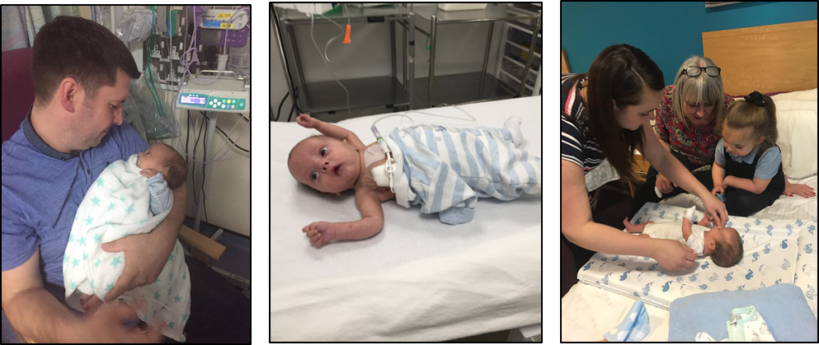
Charlie was seen quickly by doctors and diagnosed with hepatic hemangioma which is a mass on the liver. He needed an emergency operation because the mass was putting pressure on his heart, kidneys and spleen. The operation was successful. However, Charlie developed sepsis and needed further treatment.

Slide 20
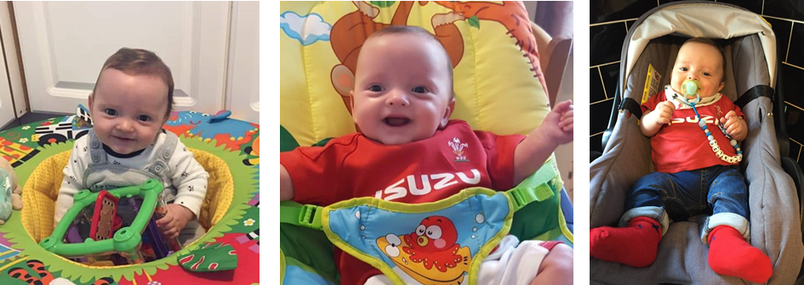
This is Charlie now. He is a happy and healthy baby who still has check ups in Birmingham but is growing well.
Thanks to the help and support of the
Wales Air Ambulance Service

Slide 21
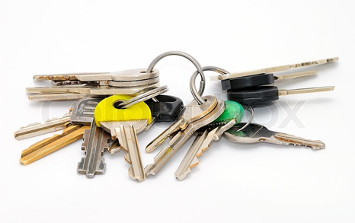
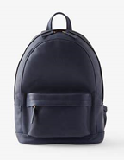


Who is going to help us raise money for our new charity?
I’m Logging you!

Slide 22
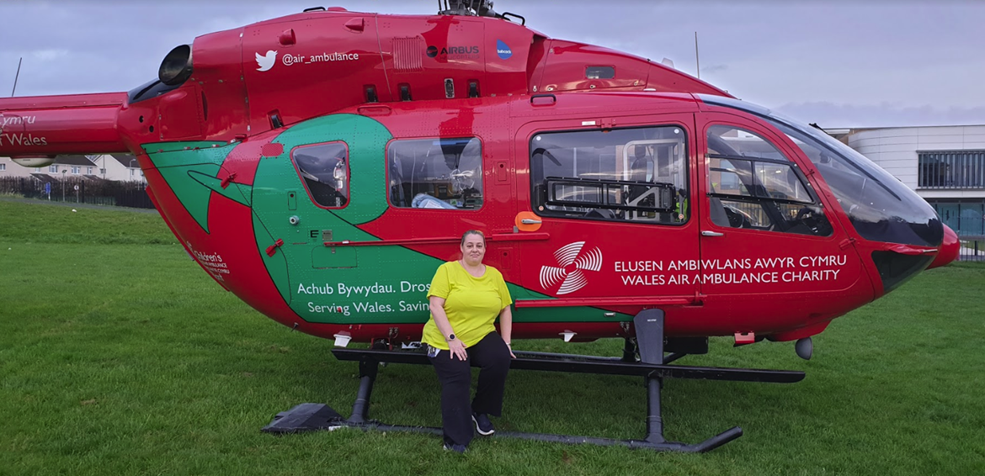
Miss Thomas

Slide 23
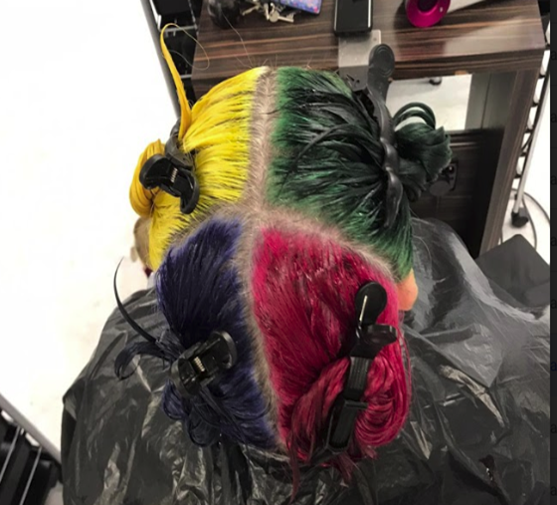
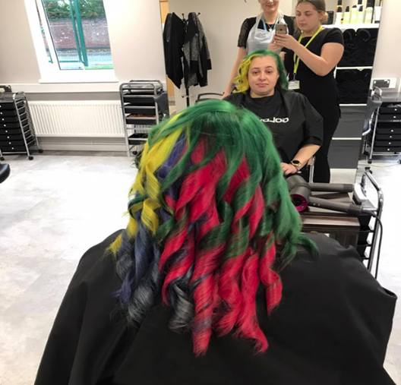
How is she going to help?
Why has Miss T dyed her hair?

Slide 24
How are we going to raise money for this charity?
Miss T is going to have her head shaved to raise money for the Air Ambulance.
You will have to donate to see her hair disappear!
Staff from each house will have to bid to cut off the ponytail in their house colour.
It will also be on the website for you to share the story with your families/friends/past pupils from Friday and a ‘just giving page to donate’.

Slide 25


Slide 26

Please give generously next week for this worthwhile cause. Thankyou!

